Slide 1
Zero-Touch Device Onboarding POC Scope and Schedule
Using Factory-Provisioned Cryptographic Device Identity for Belden Devices (PRISM, opEdge) onboarding on to Belden Cloud

Slide 2
Zero-Touch Device Onboarding – PoC Proposal
The Strategic Shift

Slide 3
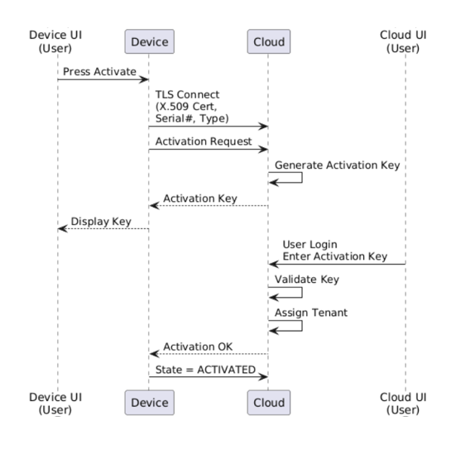
Problem: Current Onboarding Model and Limitations
Current Model:
Belden Cloud one-time generates a common “Device Certificate” for BH authentication.
Device Certificate is installed on devices, as part of firmware (filesystem).
During Onboarding, User manually adds/activates each device on Belden Cloud (Tenant Association)
Limitations:
Shared Device Certificate across all devices
Device Certificate/Keys installed on file system (extractable risk)
Manual activation required per device
Activation keys create operational friction
Slows down large-scale deployments.

Slide 4
Solution: Zero-Touch Onboarding using Device Identity
Each device is factory-provisioned with a unique X.509 cryptographic identity.
Trust anchored to Belden Root CA
Private key securely stored on-device.
mTLS over WSS for secure authentication
Device Identity-based authentication (no passwords or activation keys)
Automatic device registration and tenant association
Cloud-managed identity validation and lifecycle
Zero human interaction required
Business Impact (Illustrative):
Deployment Time Reduction
Metric | Current | Zero-Touch
Avg. onboarding time/device | ~15 min | ~1 min
1,000 device rollout | ~250 hrs | ~33 hrs
Estimated Time Reduction: 80 - 90%
Estimated Cost Reduction: 80 - 90%
Outcome:
Fully automated onboarding
Strong cryptographic security by design
Scalable fleet provisioning (10k–100k+ devices)
Reduced operational cost and deployment time

Slide 5
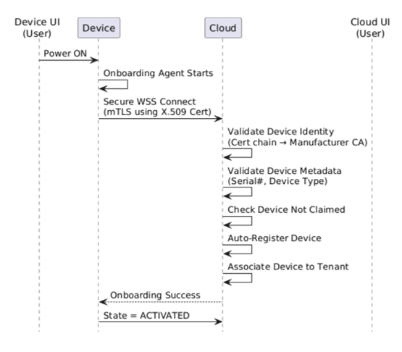
Zero-Touch Onboarding - Components & Flows
Factory (Secure Identity Provisioning):
Unique X.509 certificate per device
Private key securely stored on-device
Identity signed by Belden Root CA
No shared credentials across fleet
Device (Auto Secure Connection/Onboarding):
On power-up, device initiates cloud connection
mTLS authentication over WSS
Identity-based authentication (no passwords, no activation keys)
Zero user interaction required
Belden Cloud (use on-prem??)
Validates certificate using Belden CA trust chain
Automatically registers device
Auto-associates device to tenant
Applies policies and lifecycle controls

Slide 6
Zero-Touch Onboarding - PoC Scope
PoC Scope:
Belden-Provisioned Identity (X.509)
Secure storage of certificates and keys (filesystem-based for PoC)
mTLS-based device authentication
Backend certificate and metadata validation ( serial number product type validation)
Device auto-registration
Tenant association logic
Device state transitions (UNACTIVATED → ACTIVATED)
Out of Scope:
Hardware secure elements (TPM / HSM)
Production-grade PKI scalability
UI / Portal changes
Certificate lifecycle management at scale
High availability and disaster recovery

Slide 7
PoC Execution Plan – Resources & Budget (1)
Team & Resources:
1 Go Engineer (device onboarding go-agent)
1 Cloud Engineer (onboarding service & Device registry)
Shared access to existing infrastructure (VMs / cloud) / OnPrem Setup
Timeline (4 to 6 weeks)
Week 1: Architecture & PKI setup
Week 2–3: Device onboarding agent
Week 4: Backend onboarding service
Week 5–6: Integration, testing, demo
Risk/Dependencies:
Shared access to existing infrastructure (VMs / cloud)

Slide 8
PoC Execution Plan – Resources & Budget (2)
Tools & Technology:
Open-source PKI tools (OpenSSL / step-ca)
Existing device OS (Yocto / Linux)
WebSocket Secure (WSS)
Existing backend stack
Budget Impact
Minimal incremental cost
Primarily engineering effort
No third-party licensing required for PoC
Success Criteria
Device auto-onboards without human interaction
mTLS authentication proven via logs
Device automatically assigned to tenant

Slide 9
Thanks

Slide 10
Current Onboarding Model & Its Limitations
Current Onboarding Flow:
Device ships with Serial Number, Device Type, and a pre-installed X.509 certificate
Device starts in UNACTIVATED state
User initiates activation from device UI
Device connects to cloud and requests activation
Cloud generates Activation Key
User logs into Cloud UI and enters Activation Key (User Tenant Account)
Device is assigned to tenant and transitions to ACTIVATED state
Limitations:
Requires human interaction during onboarding
Activation Key handling introduces operational friction
Slows down large-scale deployments

Slide 11
Zero-Touch Onboarding Flow (PoC)
Device powers ON and connects to Ethernet / LTE
Onboarding agent starts automatically
Device establishes secure WSS connection to cloud
Device authenticates using X.509 certificate (mTLS)
Cloud validates:
Certificate chain to Manufacturer Root CA
Device metadata (Serial Number, Device Type)
Device is not already claimed
Cloud auto-registers the device
Device is automatically associated with a tenant
Device transitions to ACTIVATED state

Slide 12
Belden Provisioned Device Identity (BPI)
Device Identity: cryptographic device identity, not just an ID string
Defines binding between a physical device and a cryptographic key pair, asserted by Belden.
BPI => (Private Key) + (Belden-signed X.509 Certificate) + (Belden Root of Trust)
Uniqueness – each device is distinguishable
Authenticity – identity can be verified cryptographically
Non-repudiation – identity cannot be forged without the private key
Device Identity:
Device Private Key: Asymmetric key (RSA-2048 / ECC-P256 / Ed25519); Generated per device; Stored in TPM/ SoC secure storage/ Encrypted filesystem
Device X.509 Certificate: Public key certificate; Signed by Belden CA; Standard X.509 structure
Conceptually Belden Provisioned Identity is:
BPI = Proof of origin, not ownership
Cryptographic, not declarative
Immutable root, mutable derivatives
Foundation for Zero-Touch Onboarding
Enables secure supply chain trust

